Slide 1
A Federated Learning Approach towards Smart Energy Meter Data
Name — Abhishek Duttagupta
TCD ID: 22312353
Supervised by: Dr Shreejith Shanker
Date: 19/05/23

Slide 2
The Problem in hand
The explosive growth of data-hungry algorithms has raised serious concerns about data privacy in various domains[1].
The crux of the data privacy problem persists, encompassing personal, commercial, ethical, and scientific aspects[2].
The emergence of federated learning offers a solution by decentralizing data and preserving the privacy of data owners[3].
In this presentation, we will explore federated learning as a method to address privacy challenges while maintaining optimal accuracy in machine learning models.
[1] OBERMEYER, Z.,ANDEMANUEL, E. J.Predicting the future—big data, machine learning,and clinical medicine.The New England journal of medicine 375, 13 (2016), 1216. [2] EIBL, G.,ANDENGEL, D. Influence of data granularity on smart meter privacy.IEEE Transactions on Smart Grid 6, 2 (2015), 930–939.
[3] KONE ˇCN `Y, J., MCMAHAN, B.,ANDRAMAGE, D.Federated optimization: Distributed optimization beyond the datacenter.arXiv preprint arXiv:1511.03575(2015)

Slide 3
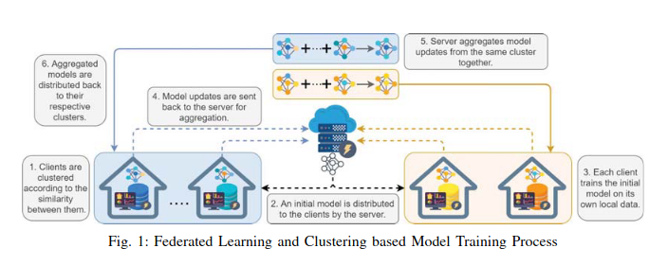
How can Federated Learning solve this problem?
Client devices perform local training, keeping data decentralized.
Model updates are sent to a central server for aggregation.
Aggregated model sent back to clients for updates with the process continuing.
Data remains on client devices, minimizing the risk of data breaches.
User-sensitive information stays local and secure.
Fig.1: Image is taken from the paper titled “Federated Learning based Energy Demand Prediction with Clustered Aggregation” by Ye Lin Tun. Fig.2: Image is taken from bitfount.com website for explanation purpose only.

Slide 4
State of Art technology
Impact of Machine Learning and Smart Grids: The integration of machine learning and smart grids has revolutionized load forecasting for dynamic energy pricing. This combination has enabled consumers to effectively plan their energy usage and costs based on accurate predictions[4]. The incorporation of deep learning techniques further has significantly enhanced the accuracy of load forecasting for the next day.
Rise of Hybrid Models: In recent times, hybrid models have emerged as a new trend in demand forecasting. These models combine different algorithms to achieve higher accuracy compared to using a singular network[5].
Examples of Hybrid Models: Some popular hybrid models used in demand forecasting include a combination of ARIMA, logistic regressions, and Neural Networks. Another effective hybrid model involves combining LSTM’s and DNN's with various time series approaches[6].
[4] DÍAZ, G., COTO, J., AND GÓMEZ-ALEIXANDRE, J. Prediction and explanation of the formation of the spanish day-ahead electricity price through machine learning regression. Applied Energy 239 (2019), 610–625. [5] SAXENA, H., APONTE, O., AND MCCONKY, K. T. A hybrid machine learning model for forecasting a billing period’s peak electric load days. International Journal of Forecasting 35, 4(2019), 1288–1303.
[6] WANG, S., WANG, X., WANG, S., AND WANG, D. Bi-directional long short-term memory method based on attention mechanism and rolling update for short-term load forecasting.International Journal of Electrical Power & Energy Systems 109 (2019), 470–479.

Slide 5
Novel approaches introduced
While federated learning has gained traction in certain medical applications, its implementation in the energy demand forecasting industry is still in the early stages. The trade-off between accuracy and computational exhaustiveness is currently being explored in the research and development phase[7].
While there are only few papers in the federated learning approach in energy demand forecasting, the novel approaches in my work are below.
K-Means Prior to Federated Learning: By training the model on readings from the same areas, rather than using a single model for a large area with significant variations, better accuracy can be achieved in energy demand forecasting.
Sliding Window Technique: By utilizing a sliding window technique to capture variations in energy demand patterns between weekdays and weekends, gives a chance of incorporating temporal changes.
Half-Hour Prediction Model: Instead of an hour-based prediction model, the study adopts a half-hour prediction model, with smaller prediction intervals might significantly improve accuracy in energy demand forecasting.
[7]Zhu, Juncen, et al. "Blockchain-empowered federated learning: Challenges, solutions, and future directions." ACM Computing Surveys 55.11 (2023): 1-31. .

Slide 6
Aim / Objective of the Project
Phase 1: Creation of initial federated learning architecture with Tensorflow Federated framework on London household energy dataset.
Data cleaning
K - Means for data division
Creation of Federated dataset
Building the tff model
Defining the server and client optimizers
Training
Draft results
Phase 2: Optimising the accuracy of the Federated Learning Architecture.
Result analysis
Creation of random client selection and different batch Model to comply non-i.i.d standards.
Change of Model Parameters or Neural Network Architecture if required ?
Optimising the client and Server parameters.

Slide 7
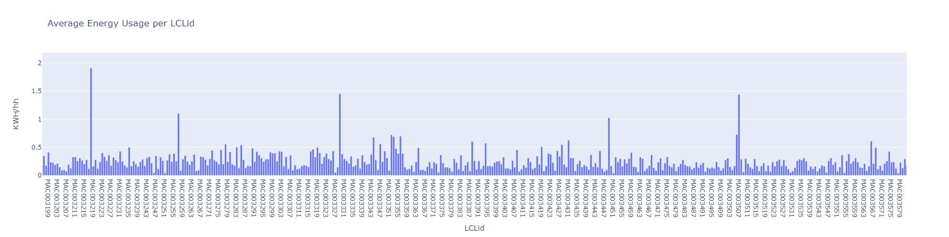
Phase - 1 Results
Data Cleaning
The London household smart energy meter dataset consists of Kwh per half hour for 5,566 customers (LCLid No’s) ranging from Nov, 2011 to Feb, 2014. Basically, the task here is to remove the Null and Nan Kwh / hh rows and remove the outlier clients. So we calculate the mean energy consumption of every customers throughout this time period and set 0.09 kwh/hh as lower bound and 1.35 kwh/hh as upper bound. Based on this, 4,672 customers are kept.

Slide 8
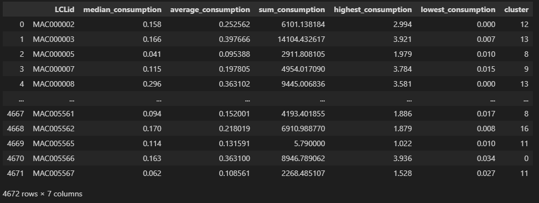
Phase - 1 Results
K - Means Clustering
The resulting 4,672 customers being spread across all over London, keeping different classes of households, income levels etc. in mind, a K-Means clustering is performed, so that similar customers fall in the same prediction cluster. As per the ACORN households classification guidelines, which divides London over 18 regions, K - Means is performed in our dataset with N = 18. The variables used for this clustering are avg Kwh/hh rating, median Kwh/hh rating, Total Kwh/hh rating, Maximum Kwh/hh and Minimum Kwh/hh rating. The results obtained from this clustering are below. For our initial demonstration, we proceed with customers falling in cluster 15, 14 and 8. The Table below shows the cluster (right most column) respective to every client.

Slide 9
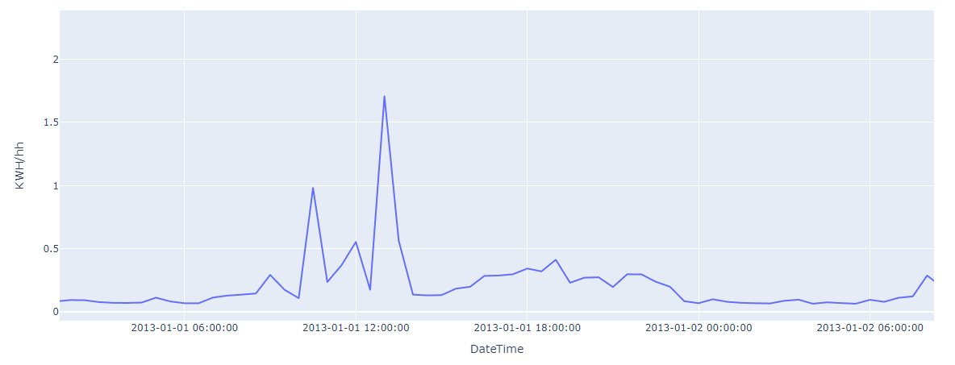
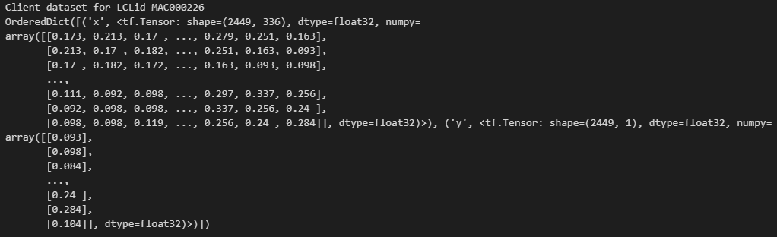
Phase - 1 Results
Creation of Federated Datasets
Creation of a Federated dataset involves creating a python ordered dictionary with Client ID’s as the tags and that respective Client’s data as a subset of that ID. The important thing, is that each variables should be converted to tensor for tensorflow federated inbuilt functions to act on.
Looking at an example client one day consumption graph (below left), we use a sliding window time series approach for our training implementation. We divide each client’s one week data (which amounts to 336 readings) into a dataset (X) and train it to predict the 337th reading. Then we train from 2nd to 337th reading and predict the 338th reading and this process goes on. A sample clients data’s will look like this with X being an array of 336 variables and Y being 1 variable.

Slide 10
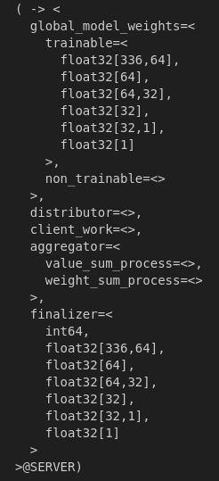
Phase - 1 Results
TFF Model & Server / Client Parameters
A simple sequential dense neural network model is created for this purpose. The input shape parameter is 336 and the network consists of three layers, with the input layer consisting of 64 units with a ‘Relu’ activation Function. The second layer is also a dense layer with 32 units and the same activation function and the output layer is with one unit and no activation function. Mean squared error and Mean absolute error are used as a loss function. A Batch size of 20 and 5 epochs are selected. For the client side, we use a learning rate of 0.02 and for the central server, we use a learning rate of 1.0. After round aggregation, the weights in the global model is shown in the right side.

Slide 11
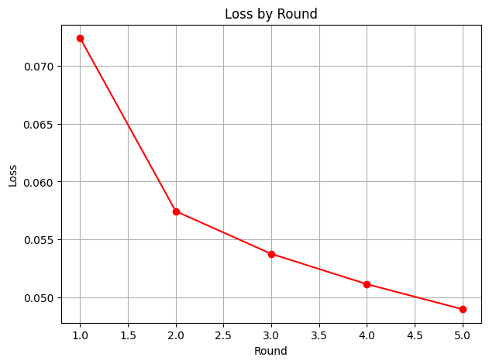
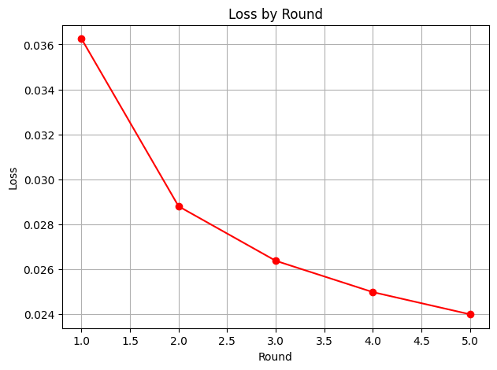
Phase - 1 Results
Client level Training
Below are results demonstrated, where the training occurred over the readings from 1st January, 2013 to 28th February, 2013 for 5 rounds, at the client level. The graphs below show the loss (Mean Squared Error) for 10 fixed clients training period from Cluster 15 (left) and Cluster 14(right), from round 1 to round 5.

Slide 12
Phase - 1 Conclusion
The demonstration takes place in a simulated environment where client identities are initially used to explore data heterogeneity and achieve a fixed selection of clients. However, In the core federated learning algorithm, client identities are not used during training, aggregation, or evaluation processes.
The initial demonstration is conducted on a fixed subset of clients, in a short span of period to enable faster convergence and facilitate client level results. For the global level, next step is come up with a way to aggregate the local level results and random data is being fed for different rounds instead of fixed dataspan.
Random Client Selection: In the next stage of the project, a random client selection algorithm will be incorporated to maintain the non-i.i.d. (independent and identically distributed) nature of the devices.

Slide 13
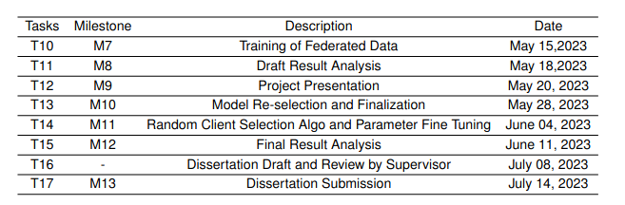
Phase - 2 (Look ahead and Plan)
The work aheads mainly deals with the optimising the results and model selected in Phase - 1
Global level model aggregation and Multiple round result analysis.
Random Client selection algorithm
Optimization of Model and client / server training parameters.
Incorporating the above, below is work schedule ahead with upcoming Milestones.

Slide 14
Mismatches explained - Interim Report vs Milestone Report
The main objective during the Interim stage was to showcase the implementation of federated learning using the TensorFlow Federated framework in software simulation and a try hardware demonstration.
For Hardware implementation, the project considered using a Microcontroller (Arduino) ahead of FPGA, because a microcontroller represented more of a energy meter that FPGA. However, due to the absence of a dedicated federated learning platform for Tiny ML, which is Arduino's module for deep learning algorithms, the hardware implementation had to be abandoned.
Hence, owing to this before the milestone report stage, the objectives were adjusted to focus on three main areas. The first objective was to demonstrate the use of the TensorFlow Federated framework in software, second objective was to optimize the algorithm's model and parameters for improved performance. The third objective involved creating a separate random client selection algorithm to highlight the challenges and importance of non-i.i.d. communication in federated learning.

Slide 15
New developments in milestone report
K-means Clustering for Data Analysis: The London dataset comprises data from over 5000 unique customers, spanning more than two years and consisting of around 15.8 million rows of KWH/hh data. To account for the diverse features and locations within London, a K-means clustering approach was used to divide the clients into 18 groups based on the ACORN London division. This clustering enables training the data with similar characteristics, enhancing model accuracy and mitigating outliers.
Algorithm Optimization: The algorithm is continually optimized through iterations involving batch sizes, epochs, and client and server parameters. This iterative process aims to achieve optimal performance and minimize model loss, leading to enhanced accuracy in the federated learning model.

Slide 16
New developments in milestone report
Random Client Selection Algorithm: Initially, a predetermined number of clients is selected from the total dataset for the algorithm. However, an ongoing effort is being made to develop an algorithm that can automatically and randomly select clients. This approach ensures the functionality of non-i.i.d. (non-independent and identically distributed) device connections, further improving the federated learning process.
Model Selection for Federated Learning: Once the federated dataset is prepared, selecting an appropriate model is crucial for achieving high accuracy. For time series problems, LSTM and dense neural networks have demonstrated superior performance. Initially, a DNN is used due to its fast convergence. Subsequently, the results are evaluated, and other models may be considered if necessary.

Slide 17
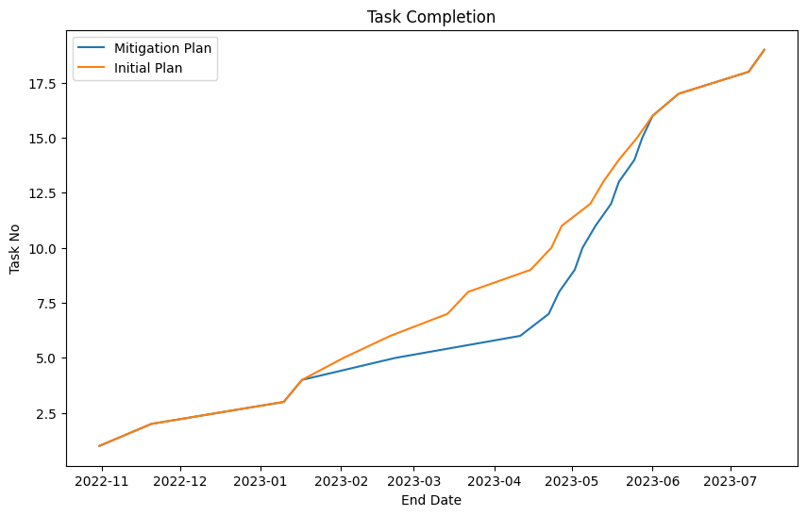
Timeline difference - Interim Report vs Milestone Report
The graph below demonstrates the progress initially planned (yellow) against the current status (blue) and path to completion, considering all the tasks mentioned in the report.
The dunk in between the graphs in majorly due to unseen difficulties not estimated during the interim report stage. The difficulty of Installing the tensorflow federated imports, was initially not considered, as tff is still a library in development. The framework had to downloaded and installed from scratch using various applications in linux ubuntu. Further, making the GPU utilized for tff computations by making the NVIDIA drivers recognised also took an unexpected time in the linux platform.

Slide 18
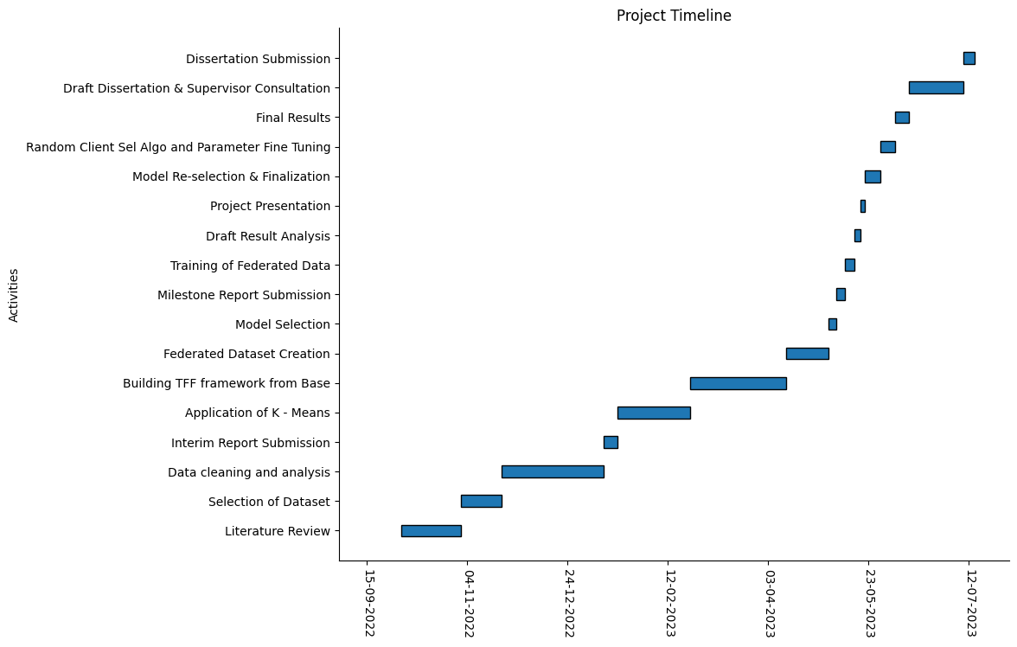
Final Gantt Chart (inc. all developments and changes)

Slide 19
Thank You

